Slide 1



Overall Customer Satisfaction
Overall Customer Satisfaction

Slide 2
Plan for Presentation
Overview
Introduction
Methodology
Analysis
Data Summary
Independent Samples
Hypothesis Tests
Chi-Square Tests
Correlations
Regressions
Conclusions
Recommendations
Limitations
Acknowledgements

Slide 3
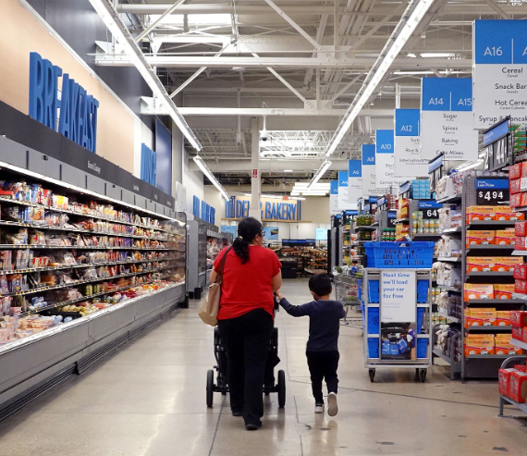
Introduction
Project Objective: Elevating the overall customer satisfaction at Walmart Stores
Driven by a deep commitment to understanding and meeting the diverse needs of Walmart's customers
We aim to not only meet but exceed customer expectations, fostering loyalty and driving sustained business growth

Slide 4
Methodology
Questionnaire drafted through Google Docs then created and dispersed through Qualtrics
Respondents are anonymous
13 questions:
4 demographic questions: gender, race, age, and income
3 preference questions
6 Likert scaled statements based on pricing, product options, customer service, product quality, curbside pickup, and their online shopping experience
Collected 386 valid responses
Utilized a convenience sample

Slide 5
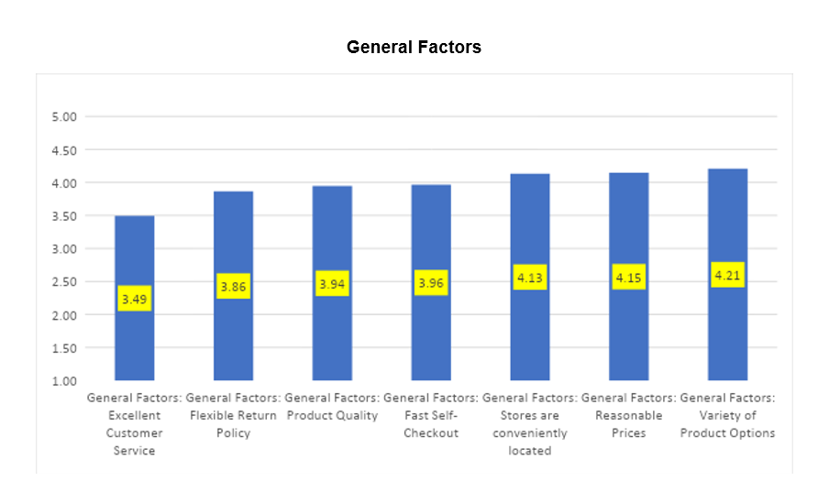
Analysis: Data Summary
Significantly greater than 4
Significantly less than 4, greater than 3
Insignificantly different from 4
Shows Walmart managers what consumers prioritize
Leverage this information and use it to propel Walmart

Slide 6
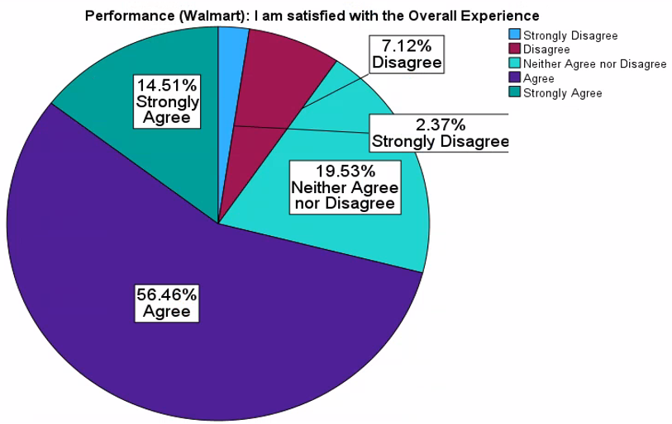
Analysis: Data Summary
70.97% of respondents agreed or strongly agreed
9.49% of respondents disagreed or strongly disagreed
Mean: 3.74
The high mean is reflective of the large percentage of respondents who hold a positive view of the overall shopping experience.
Managerial Conclusion: We recommend that Walmart adds more value to their customers’ experience by elevating their customer service and increasing their overall product quality.
Notes:
Managerial conclusion - demonstrations would enrich shopper’s experience by giving them more knowledge in regards to product offerings. Could lead to increased satisfaction because customers would have already had the opportunity to try the product prior to purchase

Slide 7
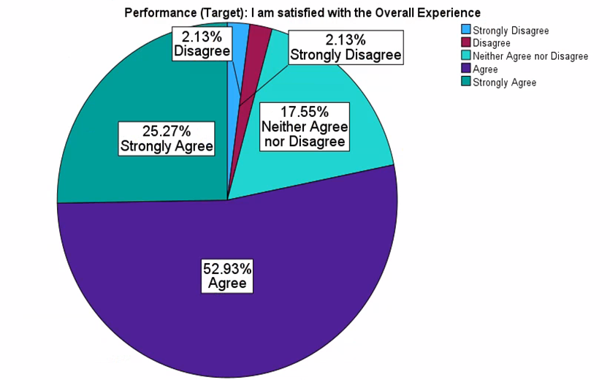
Analysis: Data Summary
78.2% of respondents agreed or strongly agreed
4.26% of respondents disagreed or strongly disagreed
Mean: 3.97
The high mean is related to the large percentage of positive responses, telling us there is a positive view of the overall shopping experience at Target
Managerial Conclusion: We recommend that Walmart try and increase its overall performance through aesthetics and comfort while shopping to compete more with Target.
Notes:
78.2% of respondents are satisfied with their shopping experience at Target opposed to 70.97% with Walmart.

Slide 8
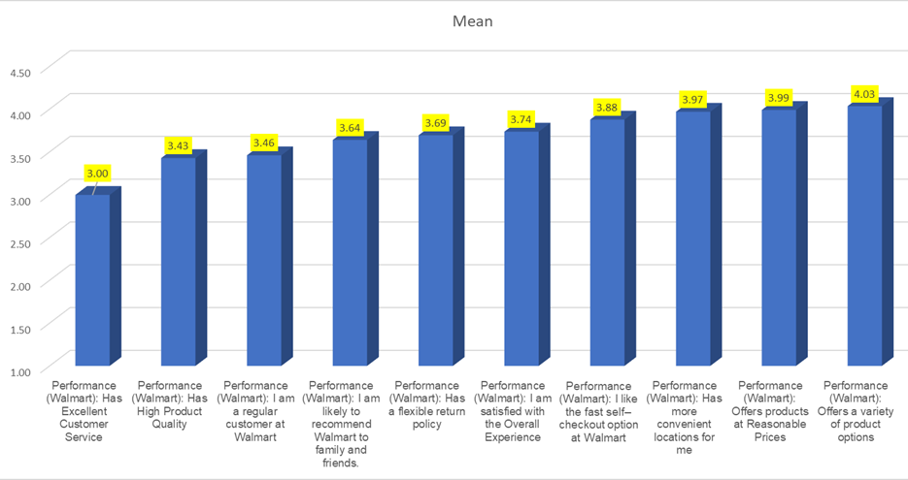
Performance (Walmart)
Test of One Mean
Insignificantly different from 4
Significantly less than 4, but greater than 3
Insignificantly different from 3

Slide 9
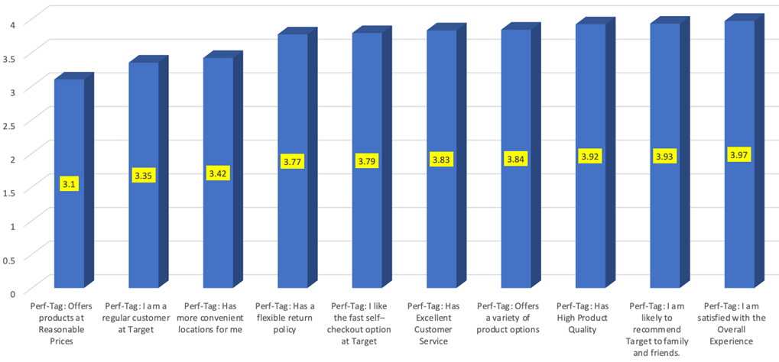
Performance (Target)
Test of One Mean
Insignificantly different from 4
Insignificantly different from 3
Significantly less than 4, but greater than 3

Slide 10
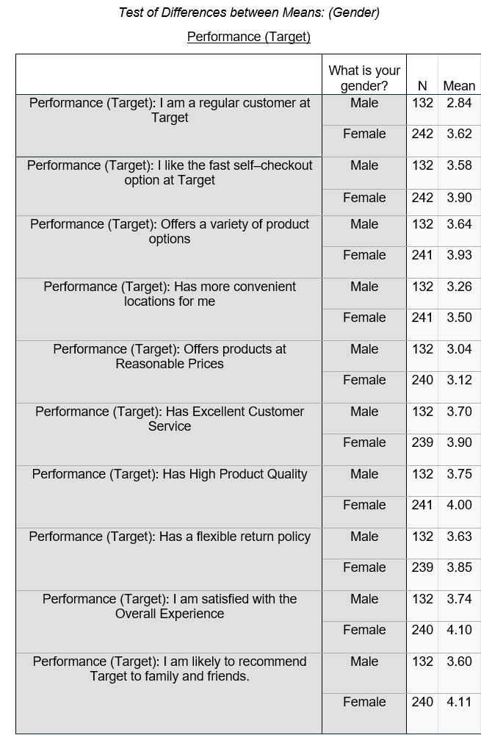
Analysis: Independent Sample T-Test
The following variables showed no significant difference between Males and Females;
Offers products at Reasonable Prices
The following variables showed significantly higher means for Females:
I am a regular customer at Target
I am satisfied with the Overall Experience
I am likely to recommend Target to family and friends
Flexible Return Policy
Offers a variety of product options
Has Excellent Customer Service
Has High Product Quality
I like the fast self–checkout option at Target
Has more convenient locations for me
The following variables showed significantly higher means for Males:
None
}
This shows us that there are significant gender segments at Target
Managerial Conclusion: There is a major gender segment between males and females in their preferences towards Target. Walmart must find a way to compete in the eyes of female consumers.

Slide 11
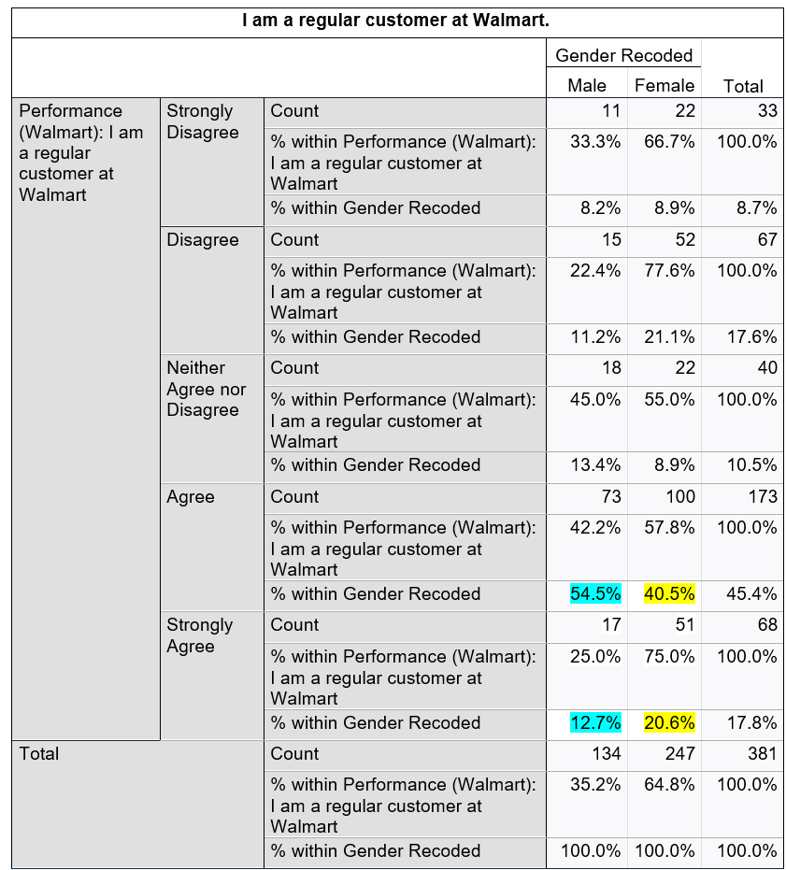
Analysis: Chi-Square Test
Level of significance = .010
There is a relationship between gender and experience at Walmart
67.2% of males agreed or strongly agreed that they are a regular customer at Walmart
61.1% of females agreed or strongly agreed that they are a regular customer at Walmart

Slide 12
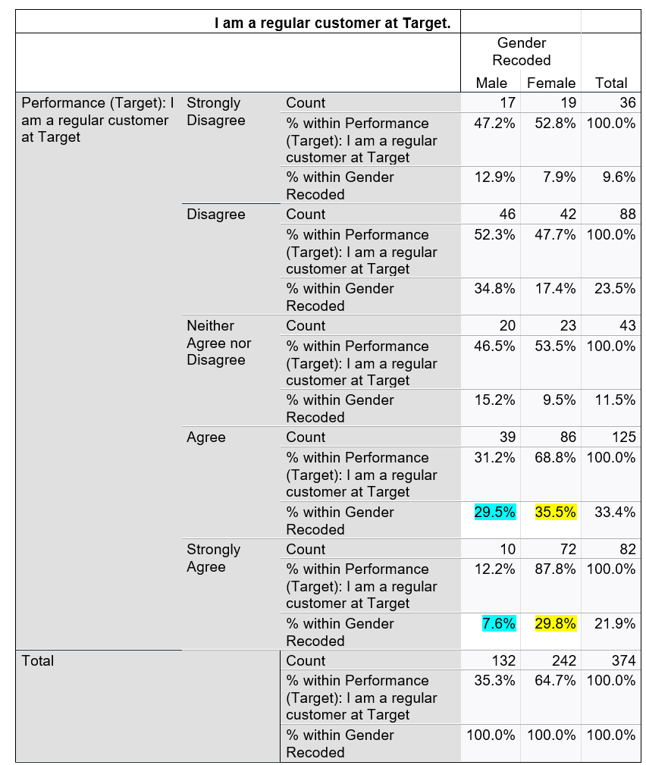
Analysis: Chi-Square Test
Level of significance = <0.001
There is a relationship between gender and experience at Target
37.1% of males agreed or strongly agreed that they are a regular customer at Target
65.3% of females agreed or strongly agreed that they are a regular customer at Target

Slide 13
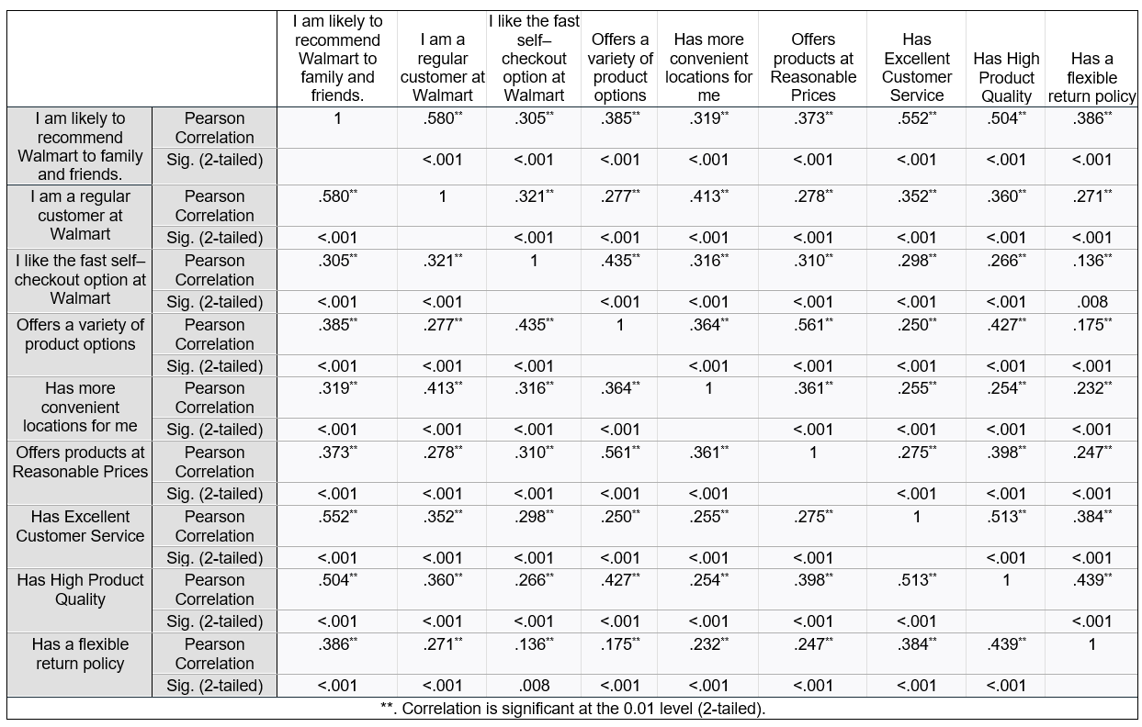
Correlation Analysis
“I am likely to recommend Walmart
to family and friends”
→
Our top row is a good reference point for the upcoming regression
Due to the halo effect, we could potentially have multicollinearity

Slide 14
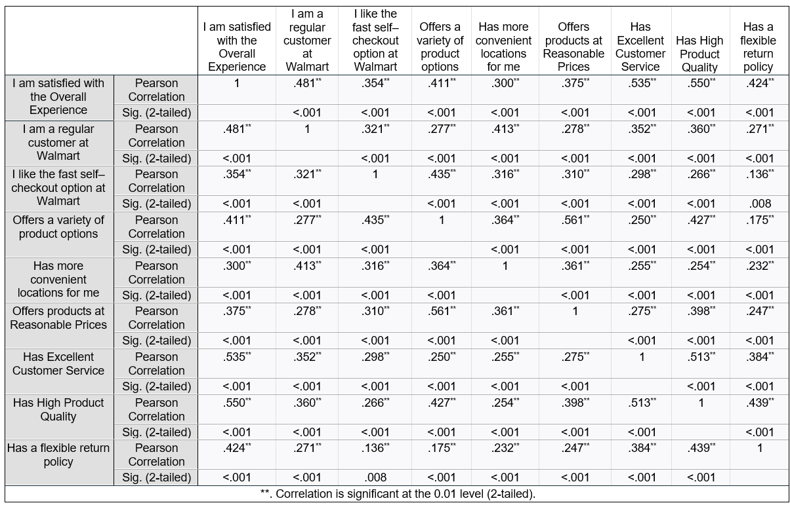
Correlation Analysis
“I am satisfied with the
Overall Experience”
Our top row is a good reference point for the upcoming regression
→
Due to the halo effect, we could potentially have multicollinearity

Slide 15
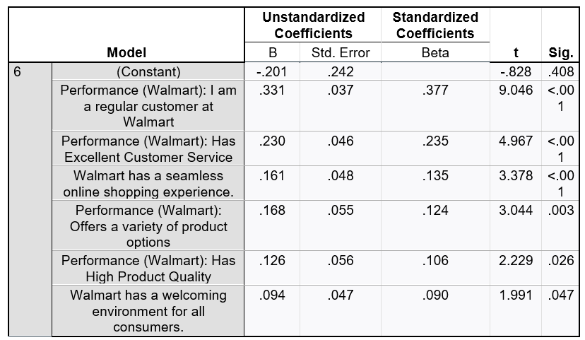
Dependent Variable: I am likely to recommend Walmart to family and friends.
Regression Analysis
Adj. R2 = 0.539
53.9% of the variance in the dependent variable
Based on the ANOVA, the regression is significant at the <0.001 level
Final Regression Equation
I am likely to recommend Walmart to family and friends =
+0.377 * I am a regular customer at Walmart
+0.235 * Has Excellent Customer Service
+0.135 * Walmart has a seamless online shopping experience.
+0.124 * Performance (Walmart): Offers a variety of product options
+0.106 * Performance (Walmart): Has High Product Quality
+0.090 * Walmart has a welcoming environment for all consumers
Managerial Conclusion: We recommend that Walmart management work on building loyalty for their regular customers (perhaps like airlines do) and improving their customer service. From the regression equation above, we see that excellent customer service plays a big role in whether or not customers are satisfied with their overall experience so Walmart must invest more time into training their employees to provide better overall service to their customers.

Slide 16
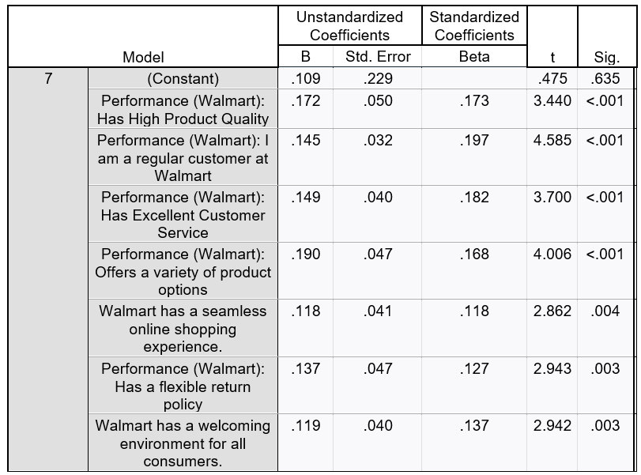
Dependent Variable: I am satisfied with the Overall Experience.
Regression Analysis
Adj. R2 = 0.515
51.5% of the variance in the dependent variable
Based on the ANOVA, the regression is significant at the <0.001 level
Final Regression Equation
I am satisfied with the Overall Experience =
+0.197 * Performance (Walmart): I am a regular customer at Walmart
+0.182 * Performance (Walmart): Has Excellent Customer Service
+0.173 * Performance (Walmart): Has High Product Quality
+0.168 * Performance (Walmart): Offers a variety of product options
+0.137 * Performance (Walmart): Has a welcoming environment for all customers
+0.127 * Performance (Walmart): Has a flexible return policy
+0.118 * Walmart has a seamless online shopping experience
Managerial Conclusion: We recommend that Walmart focus primarily on creating regular customers through excellent customer service and providing high product quality. From the regression analysis, we can see that regular customers seem to be the most correlated with satisfaction with their overall experience at Walmart.

Slide 17
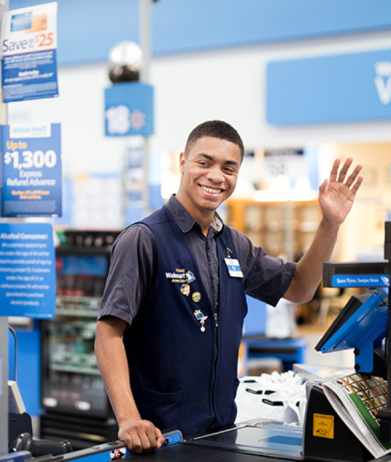
Conclusions
Women favor the shopping experience at Target over Walmart
Men seemed to feel similarly about both Walmart and Target
Walmart’s key area for improvement is customer service
Customer Service
Product Quality
Overall, Target is outperforming Walmart

Slide 18
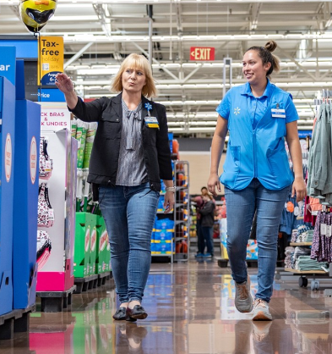
Recommendations
Because Walmart is underperforming in their customer service
We recommend that Walmart require quarterly training for their employees
Chick-fil-A example
To combat its reputation of poor product quality
Introduce a new brand called Walmart Premium
Increase store aesthetics and overall aura if they want to gain more female customers
Examples: well-lit aisles, clear signage, and attractive displays
We recommend that Walmart create a survey for customers to complete with these five variables:
customer regularity
excellent customer service
variety of product options
high product quality
possessing a welcoming environment
Notes:
Ryan

Slide 19
Limitations
Lack of literature review / secondary research
Not using a random sample
Results of Test of One Proportion
Lack of Time
Methodology Bias

Slide 20
Acknowledgements
Dr. Sethna
Our entire research team
Our Respondents
The Richards College of Business

Slide 21
Questions?

